Slide 2
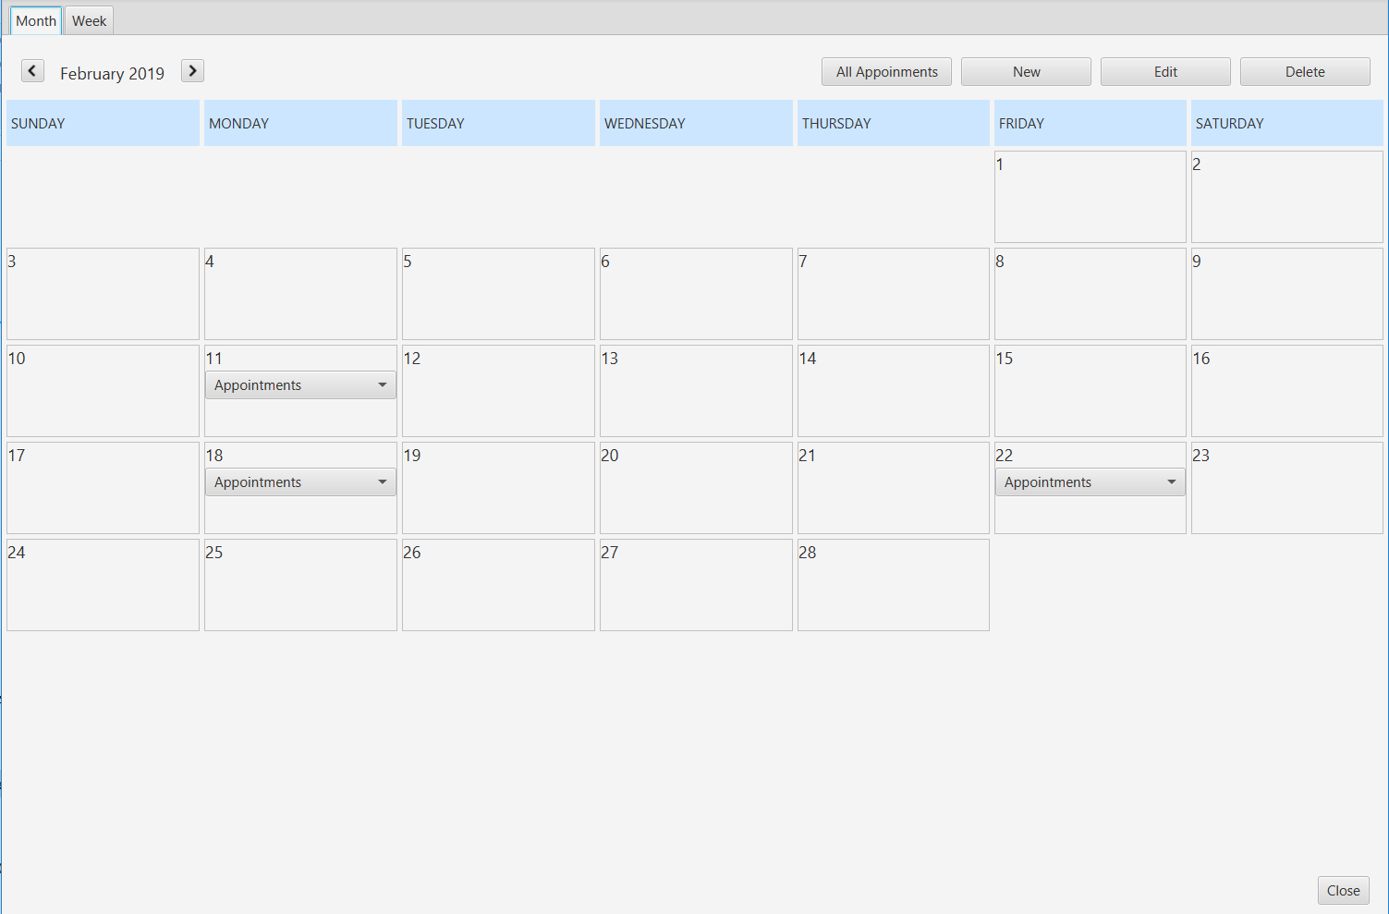
GridPane
ComboBox

